Slide 1
Bar Menu
Garlic bread 14
Bowl of mixed olives 12
Wood fired Turkish pide w caramelised onions,dips 18.5
Salt & pepper prawns, wasabi mayonnaise, pickled red onions 28
Lamb & feta meatballs w pizzaiola sauce 24
Mac `n cheese w ham off the bone 28
Battered Clevedon Coast oysters, remoulade sauce 27
Seafood chowder w wood fired bread roll, calamari, fish, mussel, prawns saffron
28
Polenta chips w sriracha mayonnaise 20
Fries w garlic aioli 12

Slide 2
Dessert Menu 16 each
Lemoncello crème brulee w vanilla ice cream
Tiramisu – layers of mascarpone cheese, sponge fingers, espresso & Marsala w maple walnut ice cream
Warm pecan pie w caramel sauce, salted caramel
ice cream
Baked cheesecake – we will inform you of today’s flavour
Apple & rhubarb crumble w vanilla bean ice cream
A choice of three scoops of ice cream
triple chocolate - strawberry - vanilla bean
salted caramel - maple & walnut
Dairy free sorbet - mango – raspberry
Affogato – two scoops of vanilla ice cream topped w a liquor of your choice served w an espresso shot
Chefs house made lemoncello or limecello 14

Slide 3
Special Coffee 16.00 each
All topped w lightly whipped cream
Caramel Irish – Bailey’s, Jamesons Whiskey, Butterscotch liquor
Kentucky Coffee – 101 proof wild turkey, American honey liquor
Café d’ amore – 100% Agave Patron coffee liquor & Nocello (Italian walnut)
Kura Paradiso - Kahlua, banana liquor, Bailey’s Irish cream
Scotsmans Pash – Scottish whisky & Drambuie
Chocolate Nutta – Hot chocolate, Frangelico, Butterscotch liquor

Slide 4
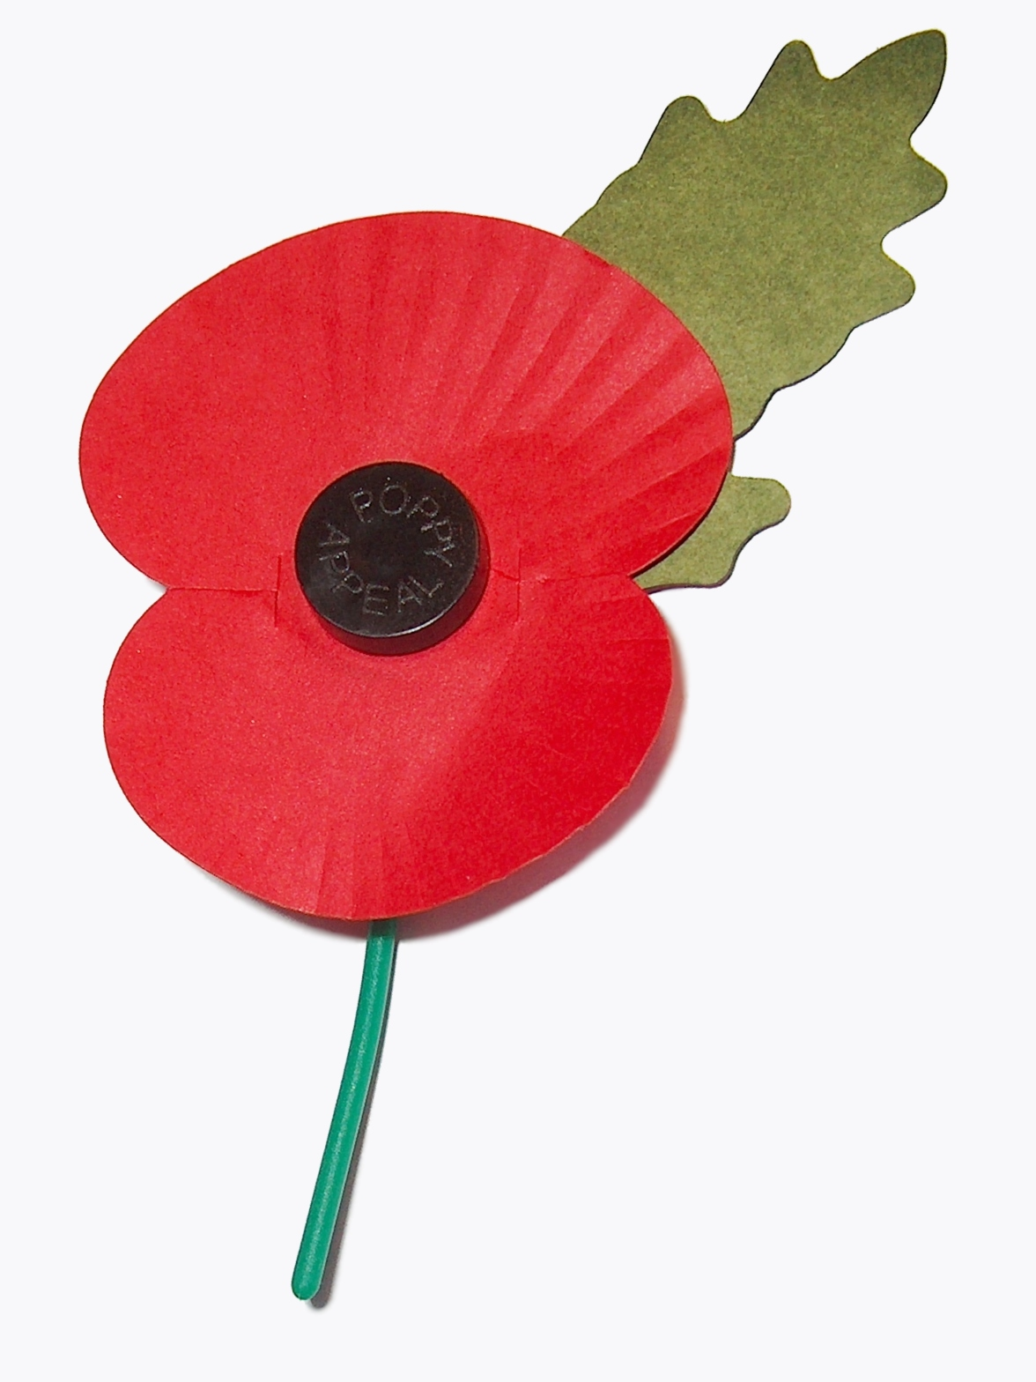
PUBLIC HOLIDAY
10%
SURCHARGE APPLIES

